Slide 1
Today’s Agenda
Top Down Approach (Divide-and-Conquer)
  Quick Sort
    Design and Elementary Analysis
    Complexity Analysis
    Randomized of Quick Sort
Minor CSE: Data Structures

Slide 2
Quicksort is a sorting algorithm whose worst-case running time is O(n²) on an input array of n numbers.
In spite of this slow worst-case running time, quicksort is often the best practical choice for sorting because it is remarkably efficient on the average: its expected running time is O(n log n), and the constant factors hidden in the O(n log n) notation are quite small.
It also has the advantage of sorting in place, and it works well even in virtual memory environments.
Minor CSE: Data Structures

Slide 3
7.1 Description of quicksort
Quicksort, like merge sort, is based on the divide-and-conquer paradigm.
Divide: The array A[p . . r] is partitioned (rearranged) into two nonempty subarrays A[p . . q] and A[q + 1 . . r] such that each element of A[p . . q] is less than or equal to each element of A[q + 1 . . r].
Conquer: The two subarrays A[p . . q] and A[q + 1 . . r] are sorted by recursive calls to quicksort.
Combine: Since the subarrays are sorted in place, no work is needed to combine them: the entire array A[p . . r] is now sorted.
Minor CSE: Data Structures

Slide 4
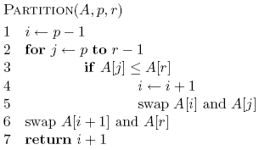
What does it do?
Minor CSE: Data Structures

Slide 5
A[r] is called the pivot
Partitions the elements A[p…r-1] in to two sets, those ≤ pivot and those > pivot
Operates in place
Final result:
p
pivot
r
A
Minor CSE: Data Structures
≤ pivot
> pivot

Slide 6
… 5 7 1 2 8 4 3 6 …
p
r
Minor CSE: Data Structures

Slide 7
i
… 5 7 1 2 8 4 3 6 …
p
r
Minor CSE: Data Structures

Slide 8
i
j
… 5 7 1 2 8 4 3 6 …
p
r
Minor CSE: Data Structures

Slide 9
i
j
… 5 7 1 2 8 4 3 6 …
p
r
Minor CSE: Data Structures

Slide 10
i
j
… 5 7 1 2 8 4 3 6 …
p
r
Minor CSE: Data Structures

Slide 11
i
j
… 5 7 1 2 8 4 3 6 …
p
r
Minor CSE: Data Structures

Slide 12
i
j
… 5 7 1 2 8 4 3 6 …
p
r
Minor CSE: Data Structures

Slide 13
i
j
… 5 7 1 2 8 4 3 6 …
p
r
Minor CSE: Data Structures

Slide 14
i
j
… 5 7 1 2 8 4 3 6 …
p
r
Minor CSE: Data Structures

Slide 15
i
j
… 5 1 7 2 8 4 3 6 …
p
r
Minor CSE: Data Structures

Slide 16
i
j
… 5 1 7 2 8 4 3 6 …
p
r
Minor CSE: Data Structures

Slide 17
i
j
… 5 1 7 2 8 4 3 6 …
p
r
Minor CSE: Data Structures

Slide 18
i
j
… 5 1 2 7 8 4 3 6 …
p
r
Minor CSE: Data Structures

Slide 19
i
j
… 5 1 2 7 8 4 3 6 …
p
r
Minor CSE: Data Structures

Slide 20
i
j
… 5 1 2 7 8 4 3 6 …
p
r
What’s happening?
Minor CSE: Data Structures

Slide 21
i
j
… 5 1 2 7 8 4 3 6 …
p
r
≤ pivot
> pivot
unprocessed
Minor CSE: Data Structures

Slide 22
i
j
… 5 1 2 7 8 4 3 6 …
p
r
Minor CSE: Data Structures

Slide 23
i
j
… 5 1 2 4 8 7 3 6 …
p
r
Minor CSE: Data Structures

Slide 24
i
j
… 5 1 2 4 3 7 8 6 …
p
r
Minor CSE: Data Structures

Slide 25
i
j
… 5 1 2 4 3 6 8 7 …
p
r
Minor CSE: Data Structures

Slide 26
i
j
… 5 1 2 4 3 6 8 7 …
p
r
Minor CSE: Data Structures

Slide 27
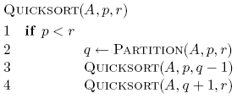
Quicksort
Minor CSE: Data Structures

Slide 28
8 5 1 3 6 2 7 4
Minor CSE: Data Structures

Slide 29
8 5 1 3 6 2 7 4
Minor CSE: Data Structures

Slide 30
1 3 2 4 6 8 7 5
Minor CSE: Data Structures

Slide 31
1 3 2 4 6 8 7 5
Minor CSE: Data Structures

Slide 32
1 3 2 4 6 8 7 5
Minor CSE: Data Structures

Slide 33
1 2 3 4 6 8 7 5
Minor CSE: Data Structures

Slide 34
1 2 3 4 6 8 7 5
Minor CSE: Data Structures

Slide 35
1 2 3 4 6 8 7 5
Minor CSE: Data Structures

Slide 36
1 2 3 4 6 8 7 5
Minor CSE: Data Structures

Slide 37
1 2 3 4 6 8 7 5
Minor CSE: Data Structures

Slide 38
1 2 3 4 5 8 7 6
What happens here?
Minor CSE: Data Structures

Slide 39
1 2 3 4 5 8 7 6
Minor CSE: Data Structures

Slide 40
1 2 3 4 5 8 7 6
Minor CSE: Data Structures

Slide 41
1 2 3 4 5 6 7 8
Minor CSE: Data Structures

Slide 42
1 2 3 4 5 6 7 8
Minor CSE: Data Structures

Slide 43
Performance of quicksort
The running time of quicksort depends on whether the partitioning is balanced or unbalanced, and this in turn depends on which elements are used for partitioning.
Minor CSE: Data Structures

Slide 44
Quicksort Analysis
Assumptions:
  A random pivot (no median-of-three partitioning)
  No cutoff for small arrays
Running time
  pivot selection: constant time, i.e. O(1)
  partitioning: linear time, i.e. O(N)
  running time of the two recursive calls
T(N)=T(i)+T(N-i-1)+cN where c is a constant
  i: number of elements in one half.
Minor CSE: Data Structures

Slide 45
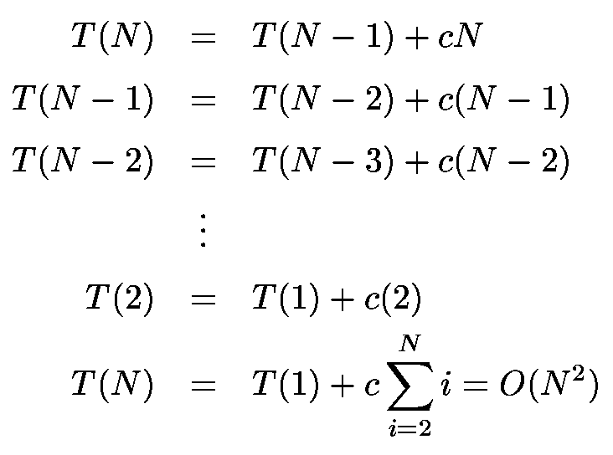
Worst-Case Analysis
What will be the worst case?
  The pivot is the smallest or the largest element, all the time
  Partition is always unbalanced
Minor CSE: Data Structures

Slide 46
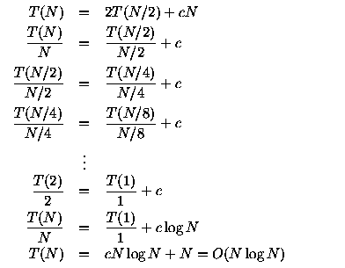
Best-case Analysis
What will be the best case?
  Partition is perfectly balanced.
  Pivot is always in the middle (median of the array)
Minor CSE: Data Structures

Slide 47
Example
pivot
2 < pivot and should go to the other side.
4
1
1
5
2
1
4
4
2
5
6
4
left
i
Interchange a[i] and a[j]
j
right
a[j] will eventually stop at a position where a[j] < pivot.
5 > pivot and should go to the other side.
Stop, because i == j.
Stop; because i > j.
Interchange a[j] and pivot.
Minor CSE: Data Structures

Slide 48
Algorithm
void QuickSort(int a[], int left, int right)
{
if (left < right)
{
pivot = a[left];
i = left;
j = right+1;
while (i < j)
{
for (i++; i<j and a[i] < pivot; i++) ;
for (j--; i<=j and a[j] >= pivot; j--) ;
if (i < j)
interchages a[i] and a[j];
}
interchange a[j] and pivot;
QuickSort(a, left, j-1);
QuickSort(a, j+1 right;);
}
}
Minor CSE: Data Structures

Slide 49
Analysis of QuickSort()
Worst case:
  Consider a list is stored.
    The smallest one is always chosen as pivot.
    In 1st iteration, n-1 elements are examined. In second iterations, n-2 elements are examined...
      Totally, the execution steps are
        n-1 + n-2 + … + 1 = O(n²)
    The time complexity is O(n²);
1
2
4
5
6
Minor CSE: Data Structures

Slide 50
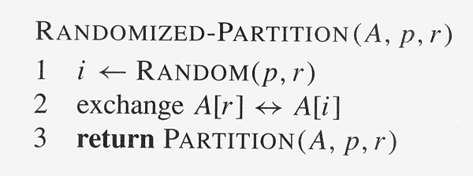
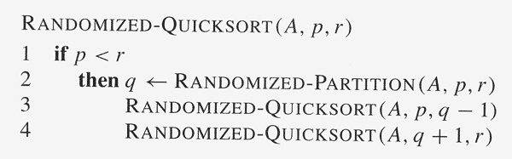
A Randomized Version of QuickSort
Add randomization to an algorithm in order to obtain good average-case performance over all inputs
Minor CSE: Data Structures

Slide 51
END
Minor CSE: Data Structures

